Slide 1
JPEG

Slide 2

WHAT IS JPEG ?
JPEG stands for Joint photographic experts group
first international standard in image compression
It could be lossy as well as lossless
STEPS OF COMPRESSION :
First step is to divide an image into blocks with each having dimensions of 8 x8.

Slide 3
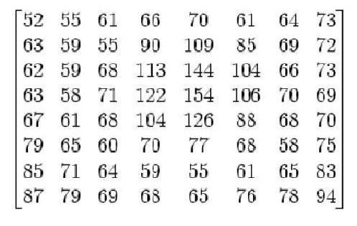
Let us say the result obtained be :

Slide 4
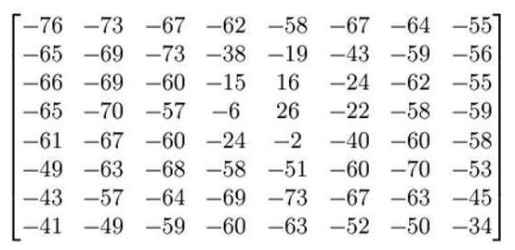
change the range from -128 to 127(Organizing in Groups)

Slide 5
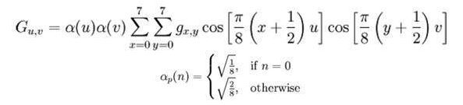
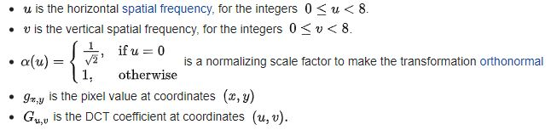
Apply DCT using
result comes from this is stored in A(j,k) matrix.

Slide 6
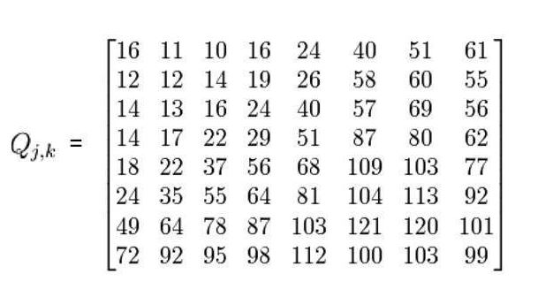
Quantisation
There is a standard matrix that is used for computing JPEG compression, which is given by a matrix called as Luminance matrix.

Slide 7

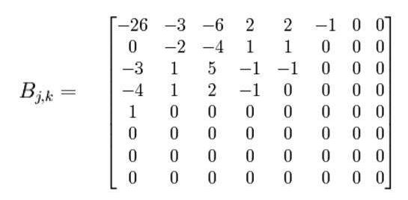
Quantization Formula :
Result into the matrix :

Slide 8
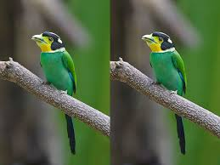
Perform zig zag until you find all zeros ahead
Hence our image is now compressed.
Perform this for all remaining blocks.

Slide 9
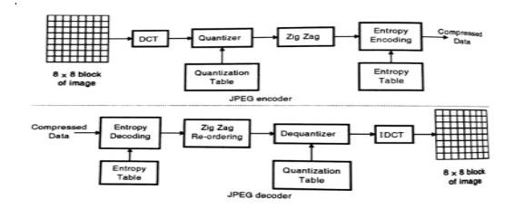

Slide 10
MPEG

Slide 11
MPEG is an acronym for Moving Pictures Experts Group
MPEG is a method for video compression
Involves the compression of digital images and sound, as well as synchronization of the two.

Slide 12
several MPEG standards
MPEG-1 is intended for intermediate data rates, on the order of 1.5 bit/sec.
MPEG-2 is intended for high data rates of at least 10 Mbit/sec.
MPEG-3 was intended for HDTV compression but was found to be redundant and was merged with MPEG-2.
MPEG-4 is intended for very low data rates of less than 64 Kbit/sec.

Slide 13
STEPS OF CONVERSION:
a motion picture is a rapid flow of a set of frames, where each frame is an image.
a frame is a spatial combination of pixels
a video is a temporal combination of frames that are sent one after another
Compressing video, then, means spatially compressing each frame and temporally compressing a set off names.

Slide 14
Spatial Compression :
The spatial compression of each frame is done with JPEG
Each frame is a picture that can be independently compressed.
Temporal Compression :
redundant frames are removed.
To temporally compress data, the MPEG method first divides frames into three categories:
I-frames, P-frames, and B-frames

Slide 15
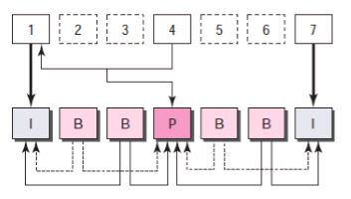
how I-, P-, and B-frames are constructed from a series of seven frames.
I-frames :
An intracoded frame (I-frame) is an independent frame that is not related to any other frame.
present at regular intervals.
must appear periodically to handle some sudden change in the frame that the previous and following frames cannot show
I-frames are independent of other frames and cannot be constructed from other frames.
MPEG frame construction

Slide 16
P-frames :
A predicted frame (P-frame) is related to the preceding I-frame or P-frame
each P-frame contains only the changes from the preceding frame
changes, however, cannot cover a big segment
P-frames can be constructed only from previous I- or P-frames
P-frames carry much less information than other frame types and carry even fewer bits after compression

Slide 17
B-frames :
A bidirectional frame (B-frame) is related to the preceding and following I-frame or P-frame.
each B-frame is relative to the past and the future
a B-frame is never related to another B-frame

Slide 18
